Slide 1

rthrtgtg
ОБЗОР РЫНКА ФАСТФУД-РЕСТОРАНОВ НЕКОТОРЫХ ГОРОДОВ США ДЛЯ
СТАРТАПА
Columbus, Ohio
Cincinnati, Ohio
Cleveland, Ohio
Las Vegas, Nevada
Miami, Florida.
Indianapolis, Indiana
Birmingham, Alabama
Portland, Oregon

Slide 2
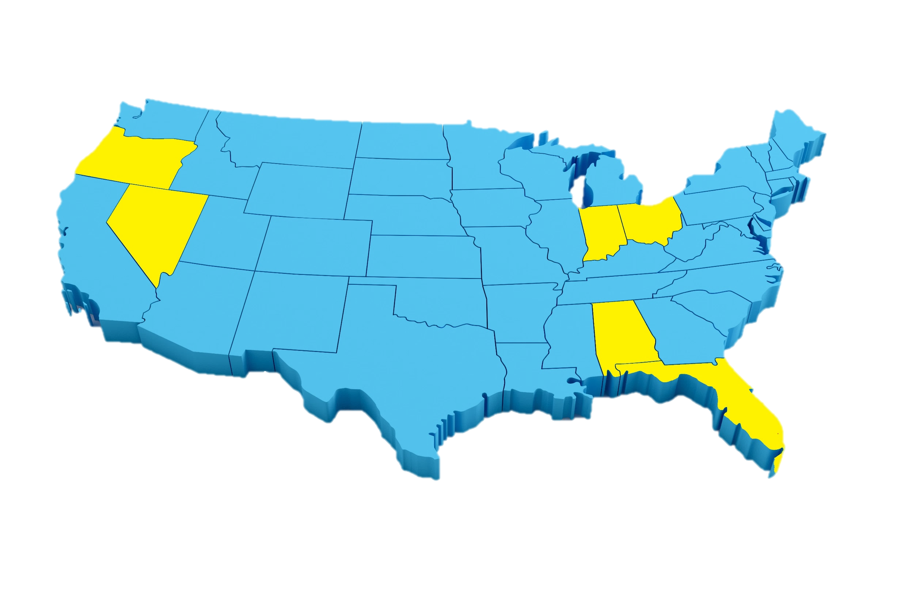

Portland
Review
Indianapolis
Oregon
Ohio
Indiana
Unit economics
Nevada
Cleveland
Columbus
Cincinnati
Alabama
Analytics
Florida
Las Vegas
Summaries
Miami
Miami

Slide 3
Portland
Review
Indianapolis
Oregon
Ohio
Indiana
Unit economics
Nevada
Cleveland
Columbus
Cincinnati
Alabama
Analytics
Florida
Las Vegas
Summaries
Miami
Miami

Slide 4
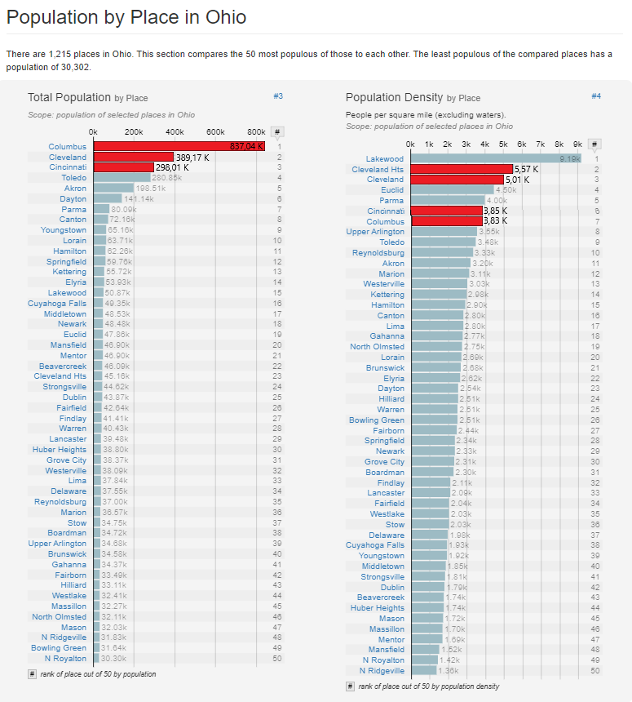
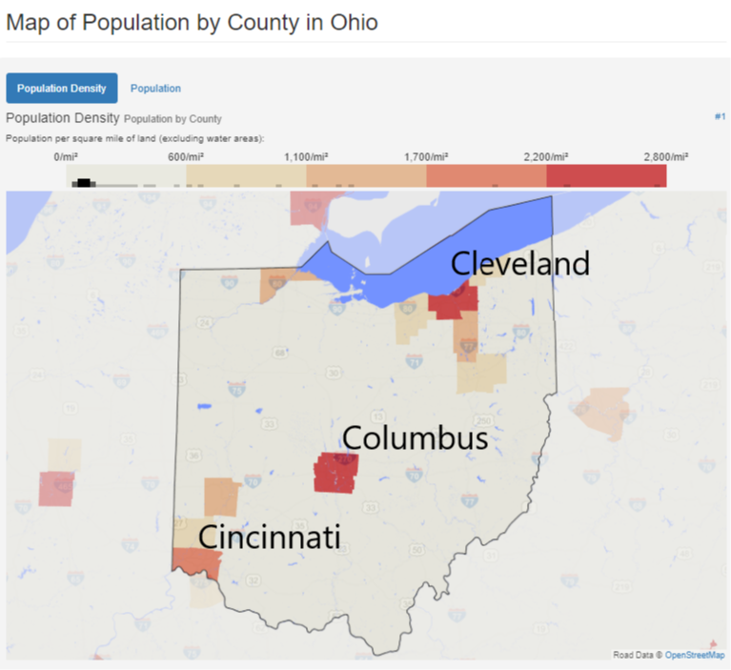
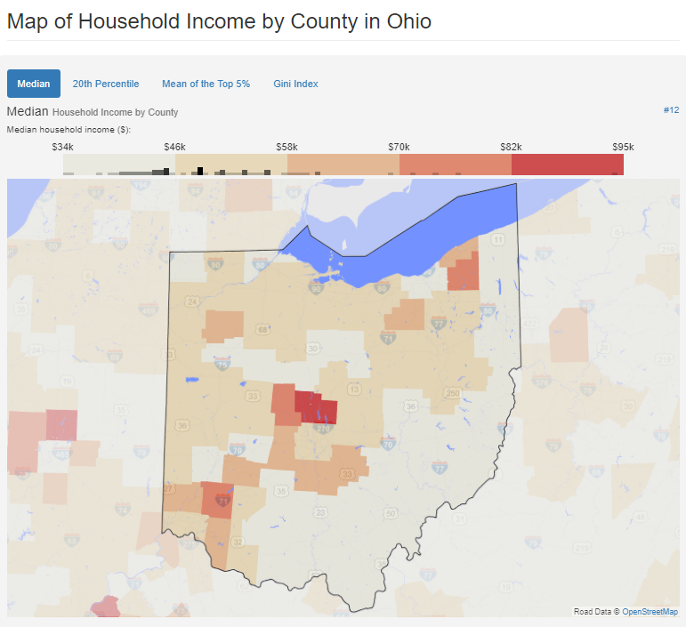
Portland
Review
Indianapolis
Oregon
Ohio
Indiana
Unit economics
Nevada
Cleveland
Columbus
Cincinnati
Alabama
Analytics
Florida
Las Vegas
Summaries
Miami
Miami

Slide 5
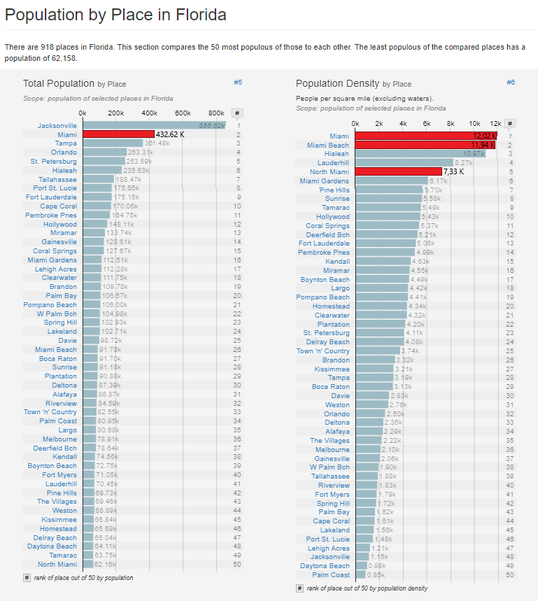
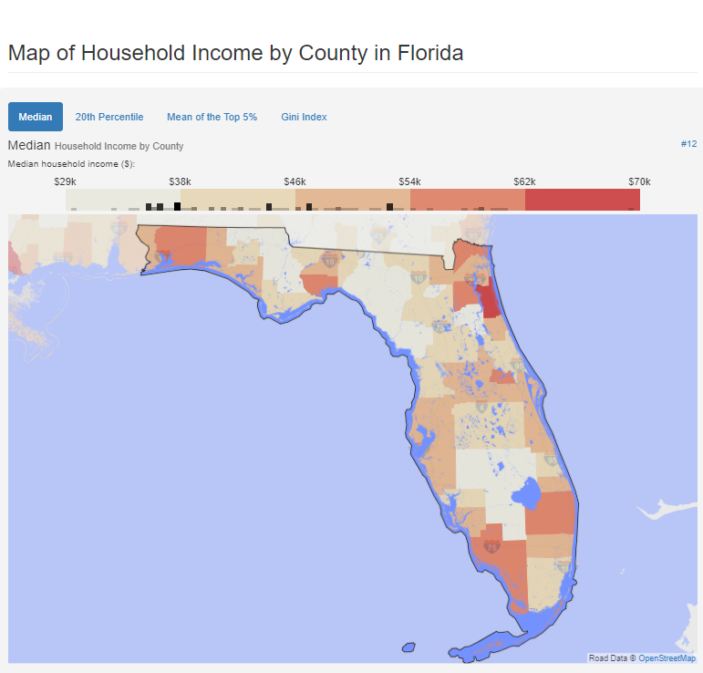
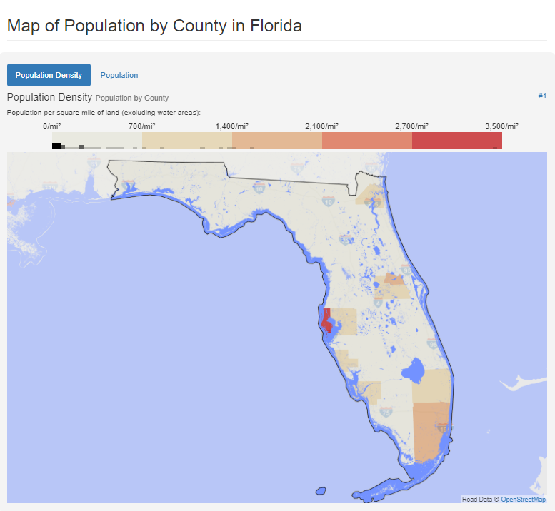
Portland
Review
Indianapolis
Oregon
Ohio
Indiana
Unit economics
Nevada
Cleveland
Columbus
Cincinnati
Alabama
Analytics
Florida
Las Vegas
Summaries
Miami
Miami

Slide 6
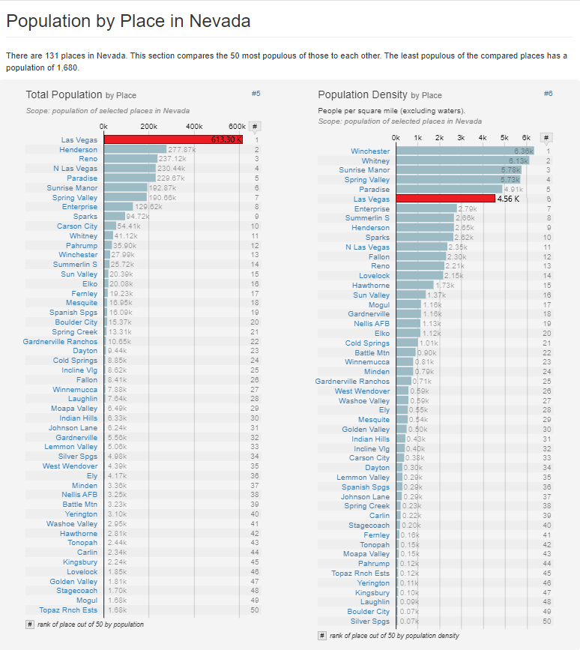
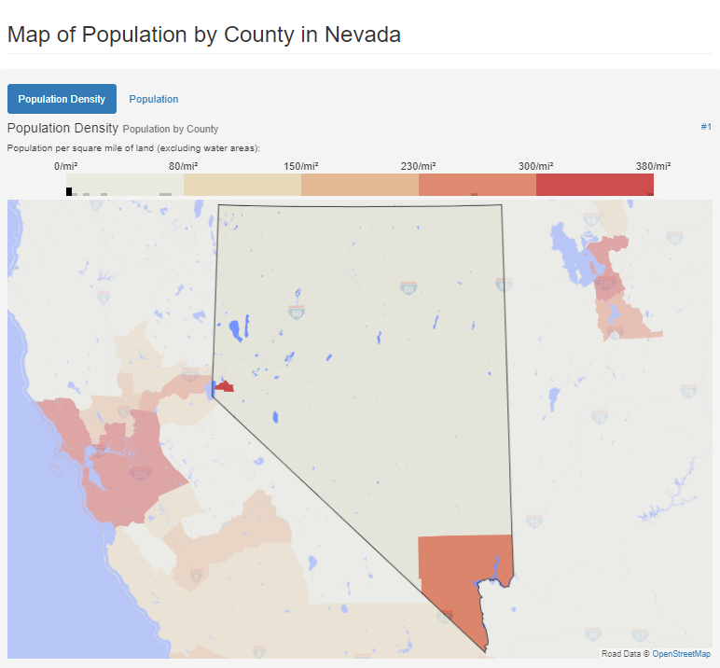
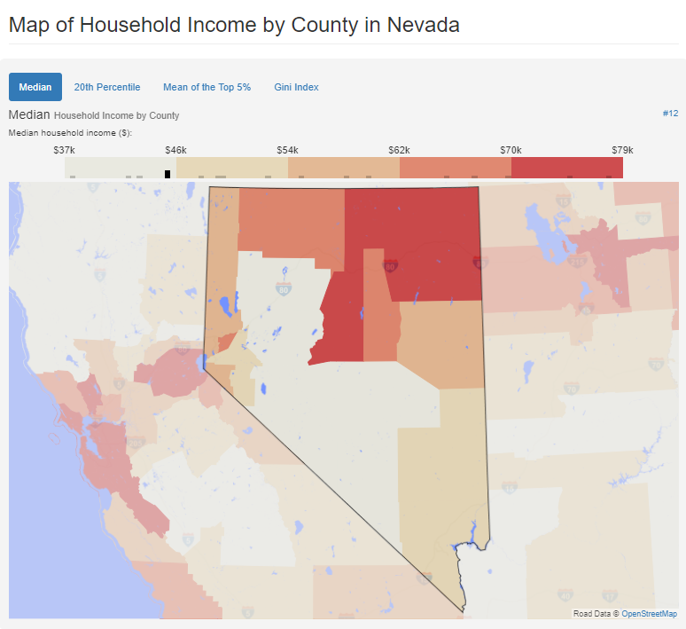
Portland
Review
Indianapolis
Oregon
Ohio
Indiana
Unit economics
Nevada
Cleveland
Columbus
Cincinnati
Alabama
Analytics
Florida
Las Vegas
Summaries
Miami
Miami

Slide 7
Portland
Review
Indianapolis
Oregon
Ohio
Indiana
Unit economics
Nevada
Cleveland
Columbus
Cincinnati
Alabama
Analytics
Florida
Las Vegas
Summaries
Miami
Miami

Slide 8
Portland
Review
Indianapolis
Oregon
Ohio
Indiana
Unit economics
Nevada
Cleveland
Columbus
Cincinnati
Alabama
Analytics
Florida
Las Vegas
Summaries
Miami
Miami

Slide 9
Portland
Review
Indianapolis
Oregon
Ohio
Indiana
Unit economics
Nevada
Cleveland
Columbus
Cincinnati
Alabama
Analytics
Florida
Las Vegas
Summaries
Miami
Miami

Slide 11
Юнит экономика
Portland
Review
Indianapolis
Oregon
Ohio
Indiana
Unit economics
Nevada
Cleveland
Columbus
Cincinnati
Alabama
Analytics
Florida
Las Vegas
Summaries
Birmingham
Miami

Slide 13
Аналитика
Portland
Review
Indianapolis
Oregon
Ohio
Indiana
Unit economics
Nevada
Cleveland
Columbus
Cincinnati
Alabama
Analytics
Florida
Las Vegas
Summaries
Miami
Miami

Slide 15
Заключение
Portland
Review
Indianapolis
Oregon
Ohio
Indiana
Unit economics
Nevada
Cleveland
Columbus
Cincinnati
Alabama
Analytics
Florida
Las Vegas
Summaries
Miami
Miami

